Slide 1
Image scraping and classification project
Submitted By:
Sumit Dhandhania

Slide 2
Business Problem Framing
Images are one of the major sources of data in the field of data science and AI. This field is making appropriate use of information that can be gathered through images by examining its features and details. We are trying to give an exposure of how an end to end project is developed in this field.
The idea behind this project is to build a deep learning-based Image Classification model on images that will be scraped from e-commerce portal. This is done to make the model more and more robust.

Slide 3
Motivation for the Problem Undertaken
In today world we are dealing with lots of data which is present in various formats like numbers ,categories, images etc. The data present in numbers or categorical form is easy to store and understand but image data is somehow different form these. In image data we have to use some different techniques to deal it and these new techniques ,algorithms to save and interpret and the way to deal image data motivates me to undertake this project and build a model for image classification.

Slide 4
Analytical Problem Framing

Slide 5
Modelling of the Problem
In this project we are dealing with image classification model that will classify between these 3 categories. This project is divided into 2 main phases.
Data Collection Phase
Model Building Phase
In data collection phase we have to scrape and collect data and after collection data we have to build convolution neural network model.
Before the model building we scraped the images of sarees, jeans ,trousers from e-commerce website Amazon.

Slide 6
Data Collection
We gathered our data from online e-commerce website Amazon. As this is image classification project of 3 categories. So we collected the images of only 3 categories i.e Sarees, Jeans and Trousers. We save these images into our local system and then using Keras and Tensorflow modules we build an image classification model.

Slide 7
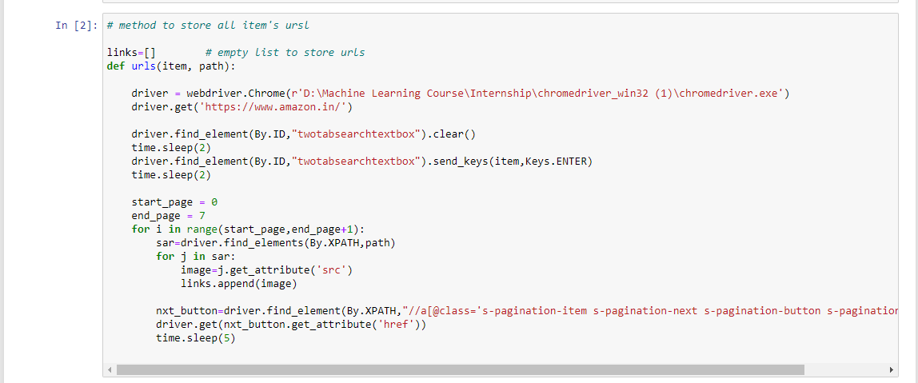

Slide 8
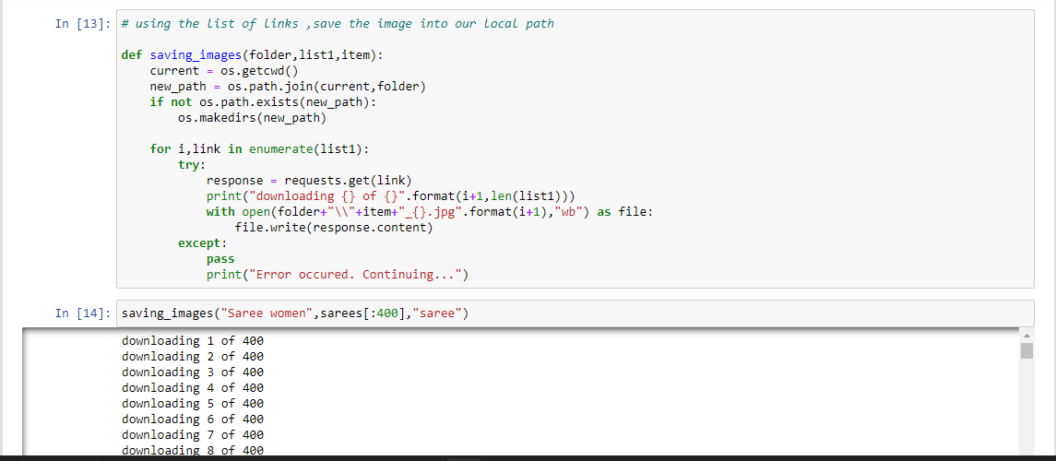

Slide 9
Data Preprocessing
In data preprocessing and model building we are using google colab for our further project needs. After downloading the images we uploaded them into drive and then using the google mount option we were able to use them in our model building phase.
Libraries required for our model building phase are :-
1. Os
2. Numpy
3. Matplotlib
4. Keras
5. Tensorflow

Slide 10
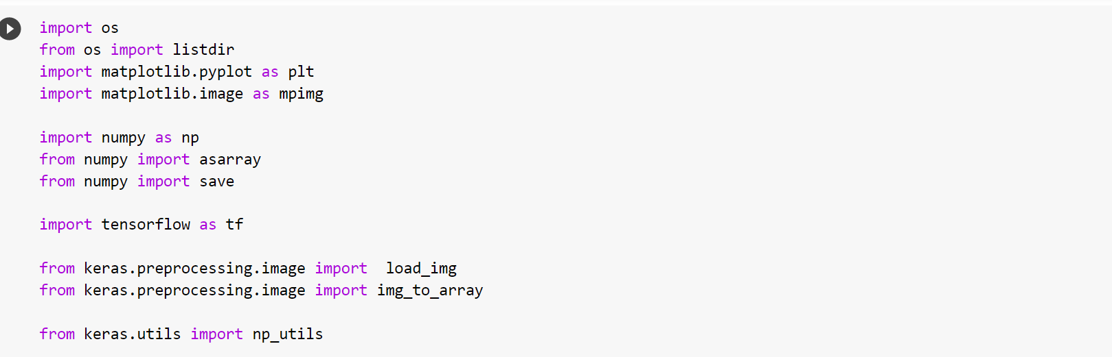
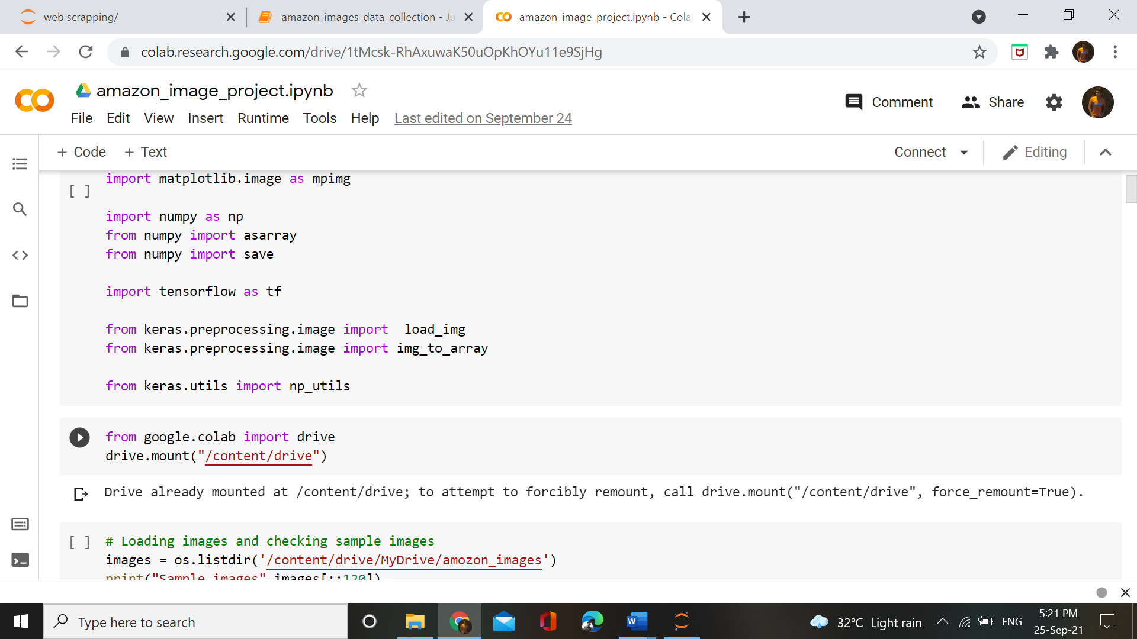

Slide 11
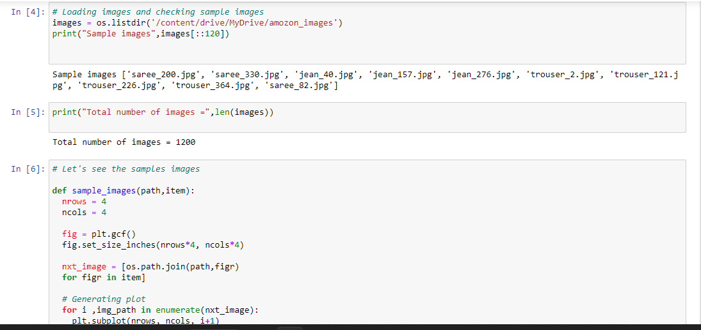

Slide 12
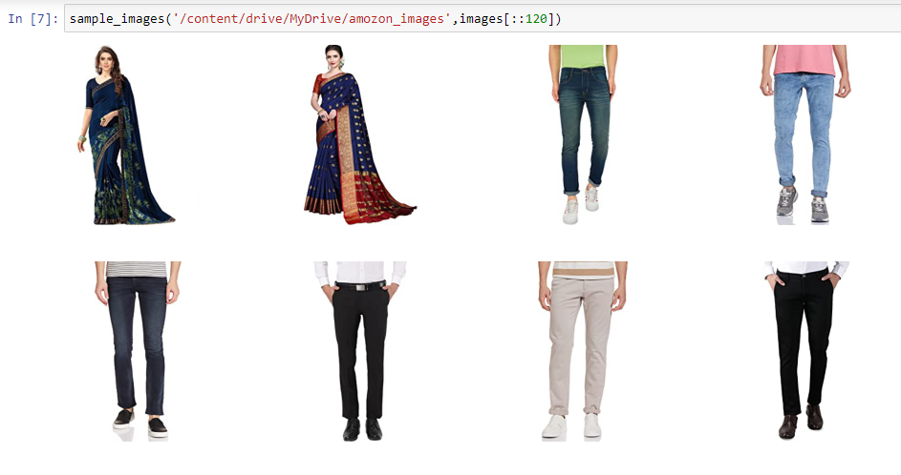

Slide 13
So after checking the images we are not in position to convert them into caler form as our system could not interpret the image. So to converting the images we again created another method. This method will find the image tag name and based on the tag name it will convert the image into an numeric form

Slide 14
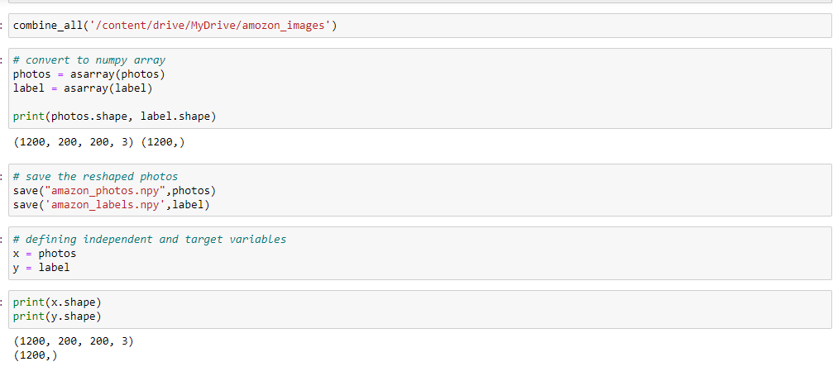
Saving the images & labels in array

Slide 15
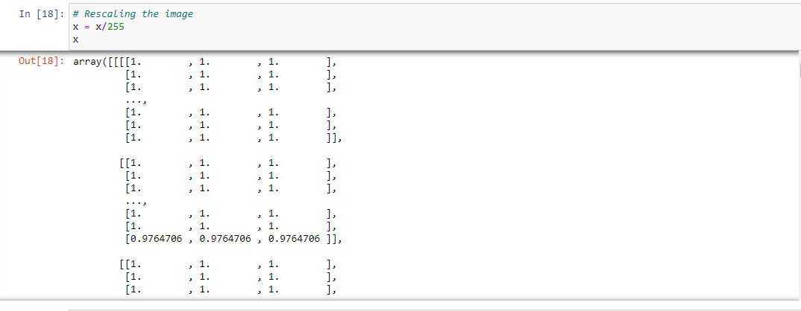
Rescaling images
After this the most important step is to rescale our independent data. We are rescaling the data into 255 scale.

Slide 16
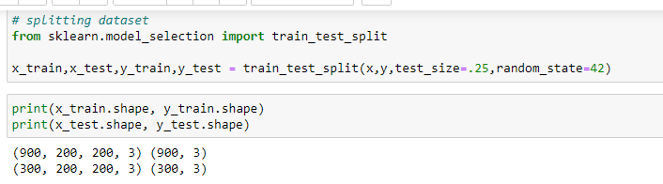
Model Building Phase
So in model building phase first of all we split our dataset into train and test data using the train_test_split model selection method.

Slide 17
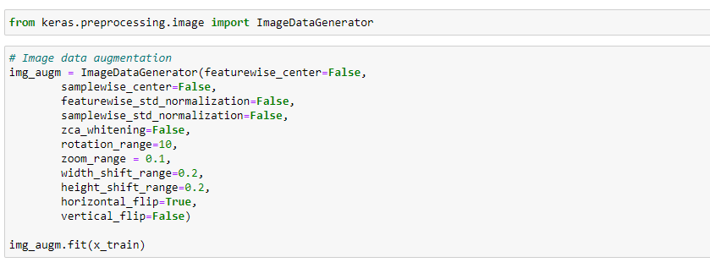
After splitting are using ImageDataGenerator technique. This technique is used for data argumentation which means to create more data from the present data. This technique will produce more data using the zoom,rotation etc methods.

Slide 18
So this is CNN(Convolution Neural Network) project, we are using the Sequential method to build our model which is present in tensorflow module. In this Sequential model we are using 6 step Convolution2d and MaxPooling layers.
In 1st layer of Convolution2d layer we are using 16 filters with a kernel size of (3,3) and the activation method used is “Relu activation”. After this Maxpooling layers follows up.
In 2nd layer of Convolution2d we increase the filter size by 2 and so on in other layers. After convolutional and maxplooing another layer present is flatteing layer-
Flattening a tensor means to remove all of the dimensions except for one. This is exactly what the Flatten layer does.

Slide 19
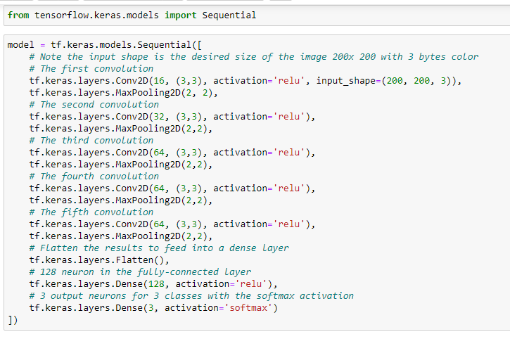

Slide 20
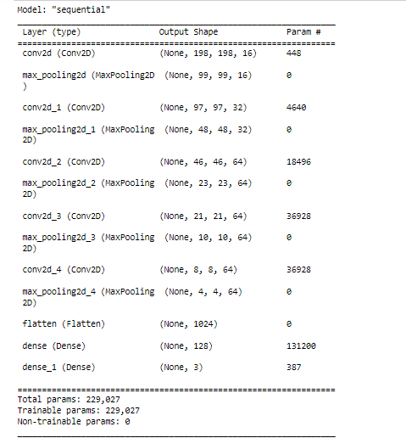
Model Summary :

Slide 21
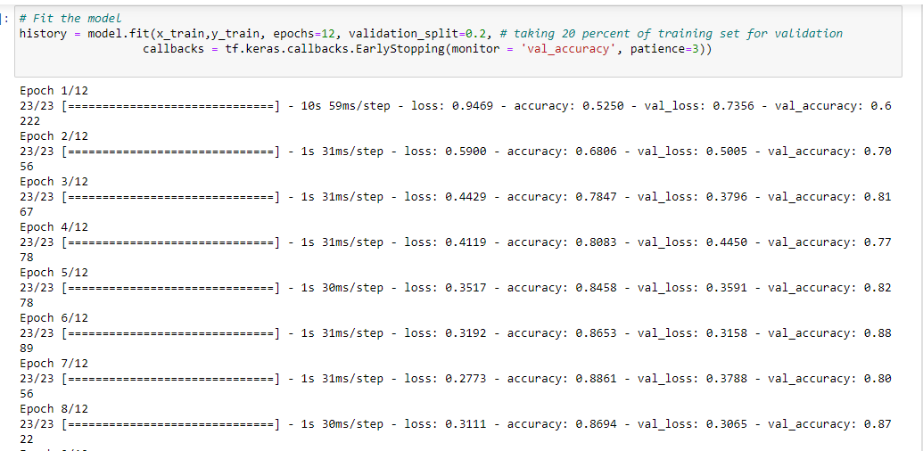

Slide 22
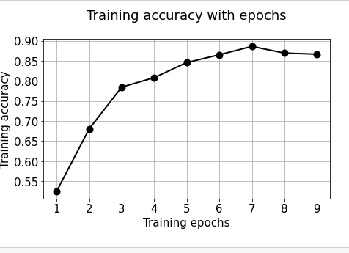
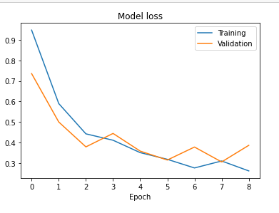
Model Evaluations :
From the above graph we find that as the epochs increases loss values also decrease and training and validation loss are almost equal at 5 epoches. After that again the validation loss starts to increase.
As clear from the above curve that there is increase in accuracy of model with increase of epochs. But 7 epochs are giving the best accuracy from model.

Slide 23
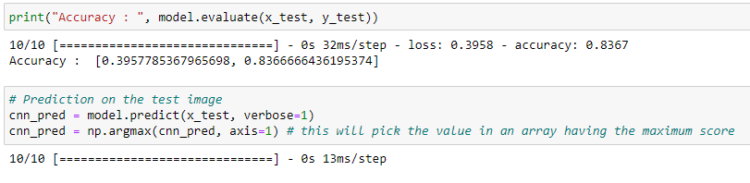
Accuracy

Slide 24
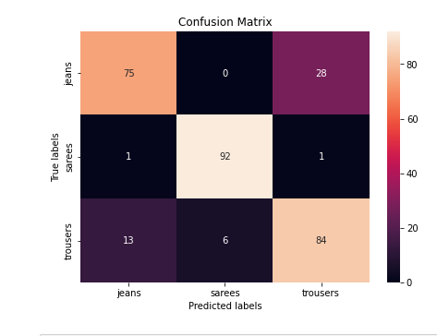
In Confusion matrix, here we are getting good result in classification of sarees but our model is somehow lacking in accurate classification between Jeans and Trousers.

Slide 25
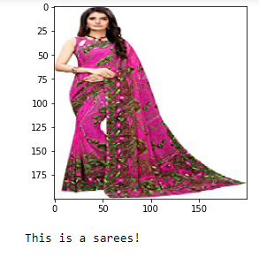
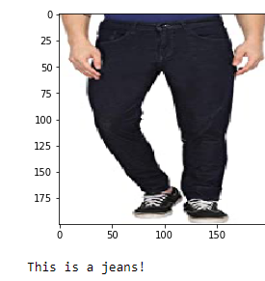
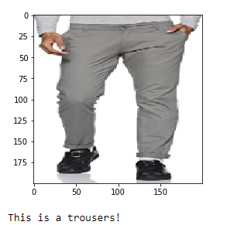
predictions

Slide 26
CONCLUSION
The image data was collected using Webscrapping from Amazon for Jeans ,Sarees and Trousers.
We have used Convolutional Neural Network for the project and giving us the accuracy of 83.67% with 0.3958 log loss.
The model is working fine.

Slide 27
Thank You

